Slide 1
Digital Marketing Overview

Slide 2
Digital Marketing Syllabus
Unit-1
Introduction
Search Engine Optimization
Unit 2
Search Engine Marketing
Basics of marketing
Unit 3
Social Media Marketing
Learn how to build brand
Search Engine working, Crawlers
Ranking algorithm and techniques etc.
Email Marketing
Inbound Marketing
content marketing
Unit 4
Web Analytics
Web Analytics Technologies
Clickstream Analysis Tools, Content and Blog Marketing
Unit 5
Mobile Marketing
Learn App-based marketing
QR codes

Slide 3

Digital Marketing Overview
Key points
What is digital marketing?
Why people going online?
Benefits of digital marketing
What does digital marketing consist of?
Search engine optimization (SEO)
Pay per click (PPC)
Social media Marketing (SMM)
Digital marketing measurement
How digital marketing evolved

Slide 4
Learning Objective
1. To discuss the digital marketing situation in India
2. To explain the concept of Digital Marketing
3. To understand the domain of Digital Marketing
4. To discuss the importance of Digital Marketing

Slide 5
Internet in india
Internet got introduced in India in 1986
but it took a decade to make it available for the public.
VSNL first launched the internet in India on August 15, 1995.
There are 358 internet service provider in India.
2nd largest in World.

Slide 6
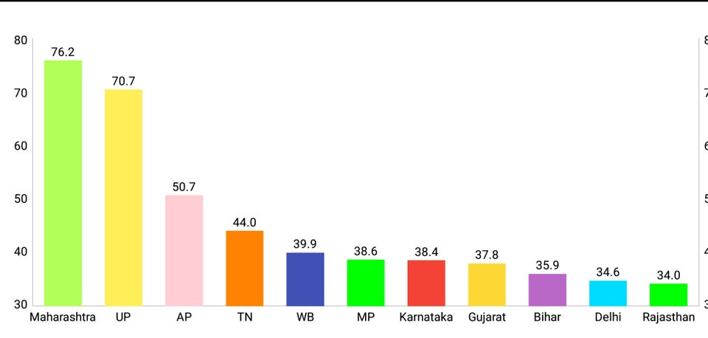
Internet Usage State wise
Source:- Reddit

Slide 7
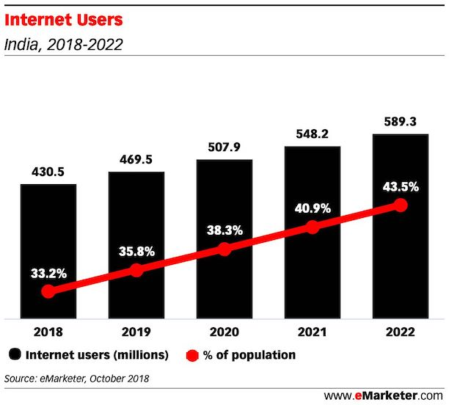
Prediction

Slide 8
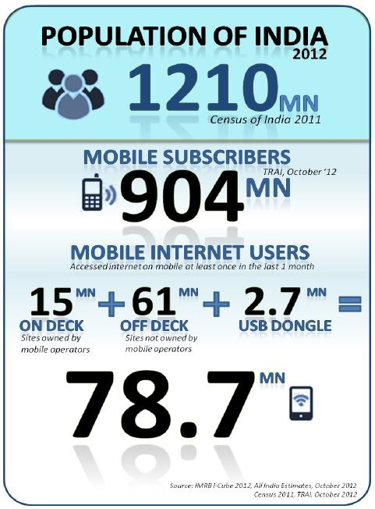
Mobile phones
0.59 GB Data Consumption-2017
2.6 GB Data Consumption-2020

Slide 9
Example
Coca-Cola Contour Digital Campaign – Case Study - YouTube

